Slide 1
A Ministerial Association Presentation
January 29 – 30
Workers’ Meeting at Andrews Motel
THE CLERGY AND LAITY: A QUEST FOR A DYNAMIC ALLIANCE

Slide 2
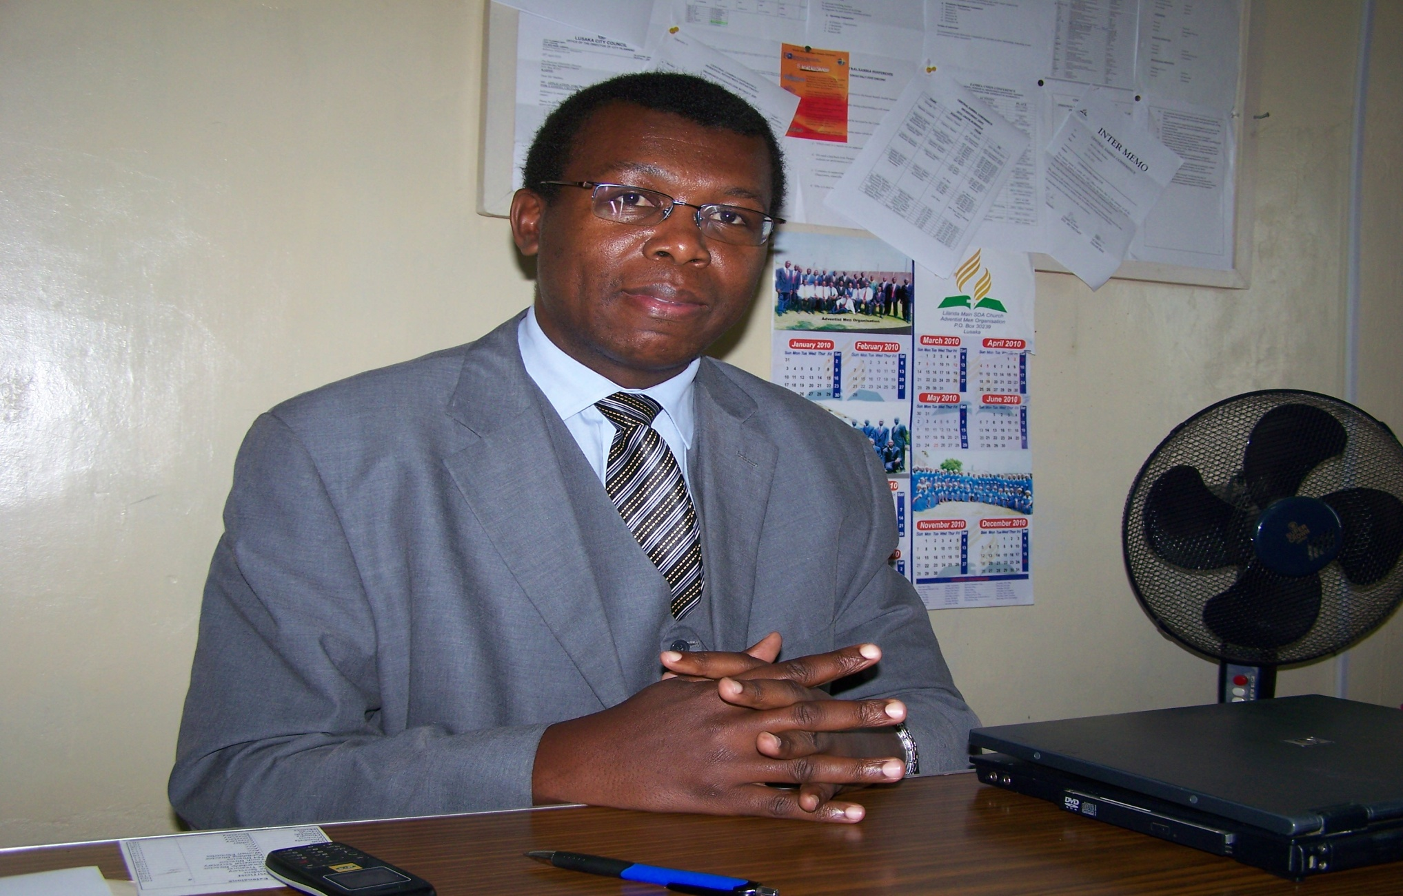
By Pastor Silas Chabala

Slide 3
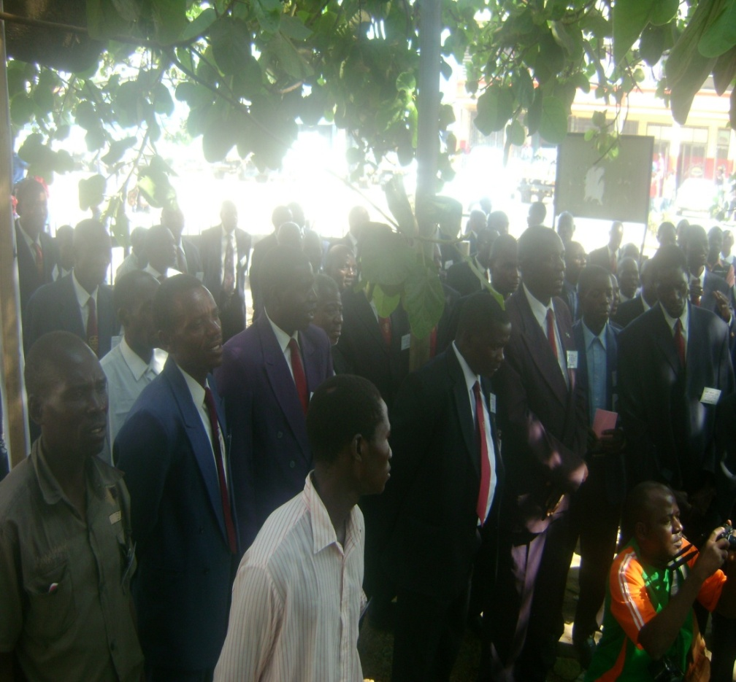
The Ministerial Association may loosely be described as a “clergy professional club”. However, from an ecclesiastical point of view, we are compelled to incorporate associated functionaries like elders and evangelists.

Slide 4
The Association has, as its purpose, the provision of support, continuing education, encouragement, and resources to ministerial workers, accomplished by providing and participating in seminars, in meetings for ministers, and in a variety of resources.
These vital workers are should be working in tandem as an ideal functional co-ministry – or are they?

Slide 5
A Consideration of Contemporary Adventist Ministerial Perceptions
In spite of Martin Luther’s stance that affirmed the “priesthood of all believers,” the aggregate change that the Reformation brought to the Roman Catholic creeds did not march the rhetoric proportionately.
There has, therefore, been a need to go beyond where these reformers reached in clarifying the concept of ministry.
The dual dependence for ministerial functions on both clergy and laity can be seen in some Protestant churches today.

Slide 6
In this regard Ellen White speaks for the church when she refers to the Holy Communion and baptism as the “two monumental pillars that are indispensable to its [church’s] spiritual welfare.” The lay leaders are allowed to participate in both and may even conduct them.
The Seventh-day Adventist church, in its policy, has specified how those exhibiting the divine call should be officially recognized and commissioned. John W. Fowler, Adventist Pastoral Ministry (Boise, Idaho: Pacific Press Publishing Association, 1990), 63.
Seventh-day Adventist Church Manual, 52.

Slide 7
two things. Firstly, we see individuals whom God has called and set apart as his message bearers to kings and common people. In all cases the inescapable fact is that God called these people. In the second instance, their nation - or the church, dully recognizes them as God’s spokespersons who have been consecrated to their special task.

Slide 8
Adventist Lay Members’ Functionality
Ellen White was prompted to castigate the system where “one man [the pastor] usually performs the labor which should be shared by two; for the work of the evangelist is necessarily combined with that of the pastor, bringing a double burden upon the worker in the field.” White, Evangelism, 116.

Slide 9
she asserted that “were every one [of you] a living missionary, the message for this time would quickly be proclaimed in all countries, to every people, and nation and tongue.”
White, Christian Service ( Takoma Park, Washington, D.C. : General Conference of Seventh-day Adventist, 1947), 9.

Slide 10
The message was that “God will send forth into His vineyard many who have not been dedicated to the ministry by the laying on of hands.”
Ellen White’s position was that the role of the clergy was that of equippers of their congregations as well as being evangelists and missionaries. White, Christian Service 67,68.

Slide 11
Clergy and Lay Roles in the S.D.A Church
Ellen White was emphatic in asserting that “it is not the Lord’s purpose that ministers should be left to do the greatest part of the work of sowing the seeds of truth.”
White, Gospel Workers, 196.
the early Seventh-day Adventist Church did not design a clergy ministry that overshadowed the ministry potential of its members

Slide 12
. The advice to the church by Ellen White in 1902 was that “there should not be a call to have settled ministers, but let the life-giving power of the truth impress the individual members to act, leading them to an efficient missionary work in each locality.”
”The Work in Greater New York”, Atlantic Union Gleaner, January 8, 1902. This article is found in the book: Ellen G. White, Testimonies: Volume 7 ( Mountain View, CA: Pacific Press Publishing Association, 1948), 54-56.

Slide 13
a paradigm shift is required to enable a given church to operate an effective ministry for all the believers – laity and clergy being mutually inclusive, not exclusive.

Slide 14
Professionals versus Laypersons?
In the modern era the chief rationale for the distinction between the clergy and laity seems to be that the former are full time in the vocation while the latter could devote some of their time to secular occupations. In this regard, Ellen White could be referring to the phenomena, in Scripture, of what we may term a “professional” or a “lay” pastoral ministry. She said that “ministers should have no engrossing interests aside from the great work of leading souls to the Savior…

Slide 15
Ministers cannot do acceptable work for God and at the same time carry the burden of large personal business enterprises (Emphasis mine).” She based her counsel on Paul’s admonition to Timothy where the former said that “no man that warreth entangleth himself with the affairs of this life; that he may please him who hath chosen him to be a soldier” [ I Timothy 2:4].

Slide 16
From the foregoing it may be deduced that some believers may be considered to be full-time gospel workers while others are more pre-occupied with the civic, business and industrial vocations as a context through which they witness for Christ. This is what creates a functional distinction between the full-time and the general gospel workers.
White, The Acts of the Apostles in the Proclamation of the Gospel of Jesus Christ (Mountain View, California: Pacific Press Publishing Association, 1911), 365.

Slide 17
Thus the clergy have merely been conferred with responsibility proportional to their greater availability for service – a position that does not confer a sacramental status on a person, but a trust.

Slide 18
A Consideration of Professionalism in the Post-modern Ecclesiastical Practice
The need to have an educated cadre of professional ministers is also a cardinal factor in the formation of a clergy with exclusive functions. Ellen White drew attention to the fact that “the times demand an intelligent, educated ministry, not novices. False doctrines are being multiplied. The world is being educated to high standards of literally attainment.” White, Pastoral Ministry (Old Colombia Pike, Silver Spring, Maryland: Ministerial Association, General Conference of Seventh-day Adventists, 1995), 43.

Slide 19
Ellen White, though advocating for a well educated clergy, sought to create a functional balance between the general membership and those in the fulltime one. She, therefore, pointed out that “it is not necessary that the word of God should be disseminated only by a few ordained ministers. The truth must be sown beside all waters.”
White, Pastoral Ministry, 157.

Slide 20
The Issue of the Professional Ministry
The medieval dichotomy of the laos, the people of God, into laity and clergy has been compounded in recent centuries by the professionalism that has come to characterize the ministry.
However, even with this level of institutionalization, the dynamic spontaneous devotion of the laity has seen them increasingly in crucial functional roles as effective lay ministers. This is mostly due to the revolutionary changes of the Reformation and the disenchantment that the twentieth-century generation exhibited toward the perceived ethical shortcomings of the professional elite in various disciplines

Slide 21
Professionalism in Our Contemporary Time
The consequences of the post-modern anti-professionalism attitudes have resulted in what may be termed as diminished confidence in the rationale for the exclusivity of ministry functions for the professional clergy.

Slide 22
“The lay preachers who were truly called by God could be seen as superior to an educated but spiritually tepid ordained ministry. The growth of the Baptist Church, which began to outnumber older established Protestant denominations… offers an indication of this trend”

Slide 23
“The earliest use of the word ‘profession’ was in relation to those who ‘professed’ vows in a religious order… Thus these religious orders provided society with artists and educators, experts in law and medicine, political advisors and leaders, as well as theologians, priests and ministers.”

Slide 24
. Thus the untrained laity could not be involved in the vocations and ministries – including the gospel ministry. This, we may say, was chiefly due to the oversight and theology of the Middle Ages.
This has affected how the laity are perceived with regard to the gospel ministry.
Russell Burrill, in his comments on the roles of the clergy and laity, argues against the dichotomy of the body of believers that the medieval church bequeathed to Christianity.

Slide 25
Burrill quotes Mellor in support of this position. The latter asserts that “the fact that the word “priest”, [iereus], is not applied in the New Testament to any office bearer in the church of Christ is, of itself, a circumstance of no mean significance. It cannot be an accident.” It may, rather, be applied to the whole body of believers.
Mellor, Priesthood in the Light of the New Testament (London: Hodder and Stoughton, 1876), 12.

Slide 26
the Seventh-day Adventist Church has had a clergy-laity relationship with no rigid and exclusive status distinctions other than the functional ones.
in 1863 its official paper carried an article, written by John Loughborough, on the question of the roles of the laity and clergy. The article was of the position that “two classes of church officers [existed]: those called especially by God, the apostles and evangelists; secondly, lay positions appointed by the church: elders, bishops, pastors, and deacons

Slide 27
.” The gist of the matter could be that the clergy are hired believers whose financial and material support from the church is necessitated by their full-time involvement in the mission field. The term “pastor” should be understood to mean both the charismatically endowed believers as well as the professional clergy.
J.N. Loughborough, The Church: Its Organization, Order and discipline (Washington: Review and Herald Publishing, 1907), 127.

Slide 28
Implications of Training a Professional Ministry
The advantage of the professionalism in the fulltime ministry is not in the admittance of rituals and sacraments but in the depth and effectiveness that the ministers bring to Christian service on account of their higher ministerial and theological training

Slide 29
This is coupled with the ecclesiastical authority that is conferred upon the minister by the employing organization. The two elements consist the major distinction between the clergy and lay ministers. The issue of ministry should, therefore, be viewed from this perspective.

