Slide 1
PERSONAL WITNESSING
TURNING THE WORLD UPSIDE DOWN !

Slide 2
theme
THE POWER OF ONE !
ONE MEMBER ONE SOUL !

Slide 3
ACTS 17:6
“ THESE PEOPLE WHO HAVE BEEN TURNING THE WORLD UPSIDE DOWN HAVE COME HERE ALSO”
WHAT WAS THE SECRET?
HOW DID THEY DO IT?
WHAT IS THE DIFFERENCE?

Slide 4
PERSONAL MINISTRIES
THE PERSONAL MINISTRIES LEADER OF THE LOCAL CHURCH TRAINS AND DIRECTS MEMBERS IN OUT REACH MISSIONARY SERVICE AND CHAIRS THE PERSONAL MINISTRIES COUNCIL WHICH MEETS ONCE EACH MONTH.
THE LEADER REPORTS IN THE MONTHLY CHURCH OUT REACH ACTIVITIES OF THE CONGREGATION
THE ASSISTANTS MAY BE ASIGNED TO COORDINATE THE BIBLE CORRESPONDENCE SCHOOL,BIBLE EVANGELISM,LITERATURE DISTRIBUTION, SMALL GROUP MINISTRIES, MEMBER TRAINING, AND OTHER SOUL WINNING PROGRAMS.
THE SECRETARY SERVES AS REPRESENTATIVE OF THE ABC FOR ALL DEPARTMENTS OF THE CHURCH AND WORKS WITH THE LEADER IN DEVELOPING THE OUTREACH PROGRAMS OF THE CHURCH.
PLEASE NOTE THAT THE PM DOES NOT DRAW UP THE PREACHING ROTA. THAT IS THE PREROGATIVE OF THE PASTOR AND BOARD OF ELDERS.

Slide 5
THE TOUGH QUESTIONS
Q-HOW DID WE GIVE THE MEANIGFUL MINISTRY TO A FEW, WHO ARE PROFESSIONARY TRAINED, WHEN GOD HAS GIFTED AND ODAINED ALL BELIEVERS FOR MINISTRY?
LIKE A STADIUM OF TEN THOUSAND SPECTATORS WATCHING THINGS HAPPEN THROUGH TWENTY TWO MEN PLAYING THE GAME, AND MAKING THINGS HAPPEN?

Slide 6
WHAT DO WE DO?
EVERY CHRISRIAN HAS A SPIRITUAL GIFT TO MINISTER WITH AS THEY WAIT FOR THE LORDS RETURN.
C.PETER WAGNER SAID-”AS FAR AS CHURCH GROWTH IS CONCERNED, LAY LIBERATION HAS OPENED UP FANTASTIC NEW POSSIBILITIES” IF LAY PEOPLE BECAME EXCITED ABOUT WHAT THEY CAN DO FOR THEIR CHURCH, THE SKY IS THE LIMIT. SO STAND UP AND BE ENVOLVED.

Slide 7
WITNESSING: A CHRISTIAN FUNDAMENTAL
THE BOOK OF ACTS BEGINS WITH A SHORT ACCOUNT OF JESUS,S LAST DAYS ON EARTH, AFTER WHICH LUKE SWIFTLY MOVES INTO HIS STIRRING PORTRAYALS OF THE SPREAD OF THE GOSPEL, AND THE GROWTH OF THE CHURCH. HE BEGINS THESE PORTRAYALS WITH A DESCRIPTION OF JESUS FOLLOWERS, AS THEY ARE BEING FILLED WITH THE HOLY SPIRIT (ACTS 2) THIS WAS AN EVENT WHICH LAUNCHED THEM INTO THE WORLD WITH THE POWER NEVER BEFORE SEEN.

Slide 8
The purpose of the church
THE CHURCH IS IN THE WORLD FOR THREE REASONS;
TO GLORIFY THE NAME OF THE LORD, IN WORD,AND IN DEED;MEANING A TOTAL DEDICATION TO THE PURPOSE OF THE CREATOR.
TO EDIFY THE BODY OF CHRIST; THROUGH PRAYER FOR ONE ANOTHER,ENCOURAGING EACH OTHER etc
THE EXTENTION OF THE KINGDOM; GOD WANTS HIS CHURCH TO GROW AND PROSPER, AND BE THE SALT AND THE LIGHT FOR THE EARTH,MT5:13,14

Slide 9
Church growth
DEFINITION-CHURCH GROWTH IS TEACHING AND TRAINING AND MODELING TO THE MEMBERS TO BECOME WHAT GOD DESIRES THEM TO BE, SO THAT THEY CAN WIN PEOPLE TO THE LORD JESUS CHRIST AND HIS CHURCH. THUS CHURCH GROWTH IS A SPIRITUAL AND YET PRACTICAL CONVICTION COMBINING THE ETRNAL PRINCIPLES OF GODS WORD WITH THE PRACTICAL INSIGHTS OF REACHING THE LOST.

Slide 10
THE KINDS OF CHURCH GROWTH
NUMERICAL GROWTH;
THE TOTAL NUMBER OF DISCIPLES JESUS LEFT WERE 120(acts1:13-15) BUT AFTER THE MIGHTY MOVEMENT OF THE HOLY SPIRIT ON THE DAY OF PENTACOST; THOSE WHO ACCEPTED THE MESSAGE AND WERE BAPTIZED TOTALD ABOUT 3,000 (acts2:41)
2.GEOGRAPHICAL GROWTH;
THE GOSPEL SPREAD NOT ONLY TO INDIVIDUALS FROM ONE PERSON TO THE OTHER, BUT ALSO FROM PLACE TO PLACE; FROM JERUSALEM TO ROME, AND ANTHENS,
(acts1:8, 9:15)
3.QUALITATIVE AND QUANTITATIVE GROWTH- COMMUNITIES THROUGH OUT THE WORLD ALSO EXPERIENCED BOTH NUMERICAL GROWTH AND QUALITY GROWTH. QQGC,S-BESIDES AN INCREASE IN NUMBERS, AND IN GEOGRAPHICAL OUTREACH, THE NEW DEVELOPING CHRISTIAN DEFINITE DEEPENING OF SPIRITUAL LIFE, AN INCREASE IN GODLY LIVING FOLLOWED THE PREACHING OF THE GOSPEL

Slide 11
4.CENTRIPETAL & CENTRIFUGAL GROWTH
CENTRIPETAL-IS INREACH GROWTH. THE CENTRIPETAL MODEL IN TODAYS WORLD IS LETTING YOUR LIGHT SHINE.
CENTRIFUGAL-IS OUTREACH, WHEN THE DISCIPLES BECOME REAL SOLDIERS IN GODS ARMY-THE CHURCH BECOMES MILITANT, CLOTHED IN THE GOSPEL ARMOR AND IT STARTS TO MARCH TO BATTLE.

Slide 12
THE MOST RECEPTIVE TIMES
THE GOSPEL IS WELL RECEIVED AND SOUGHT AFTER, WHEN WE ARE CONFRONTED WITH A THRETENING SITUATIONS AS IS SHOWN BELOW;

Slide 13
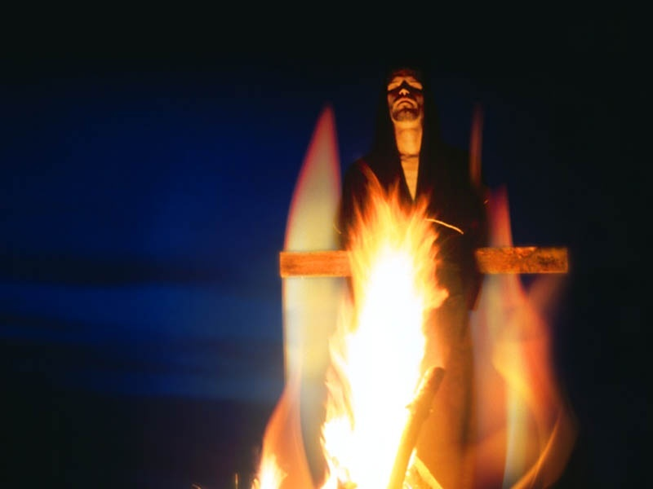
POLITICAL/RELIGIOUS PERSECUTIONS-GOD

Slide 14
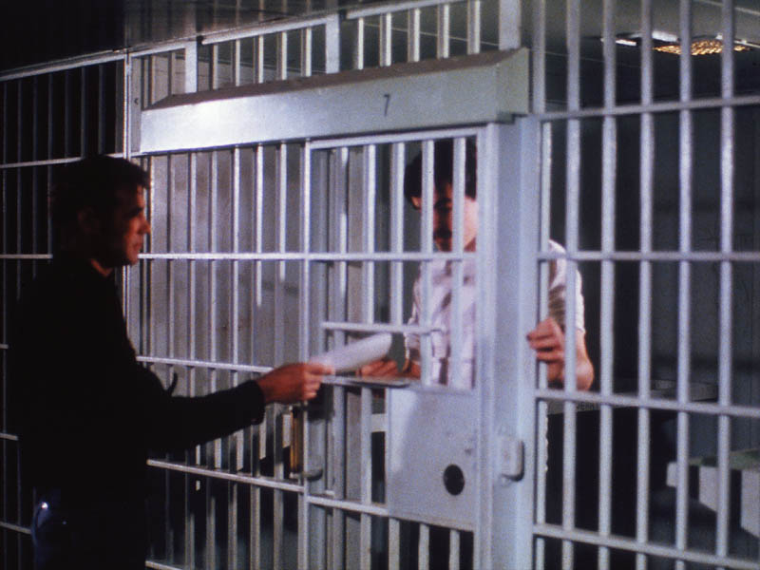
IMPRISONMENT-GOD

Slide 15

OPHANED-GOD

Slide 16
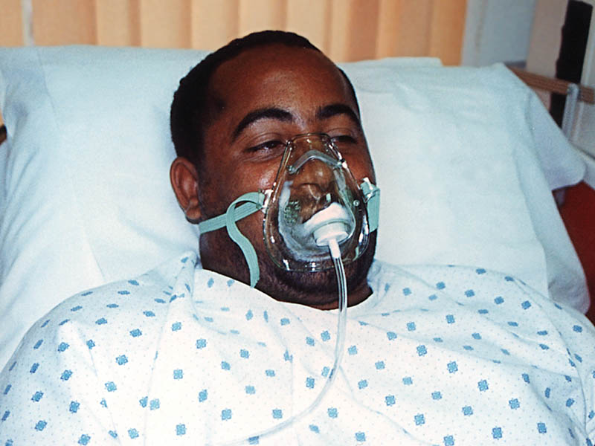
CRITICAL CONDITIONS-GOD

Slide 17
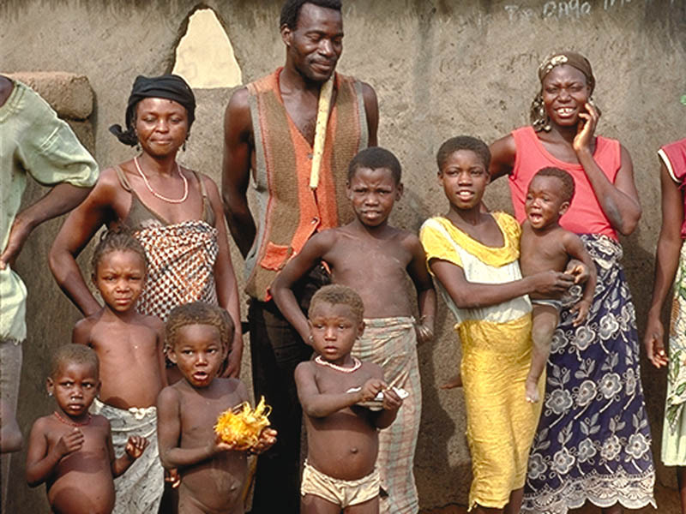
POVERTY-GOD

Slide 18

JOB LOSS-GOD

Slide 19
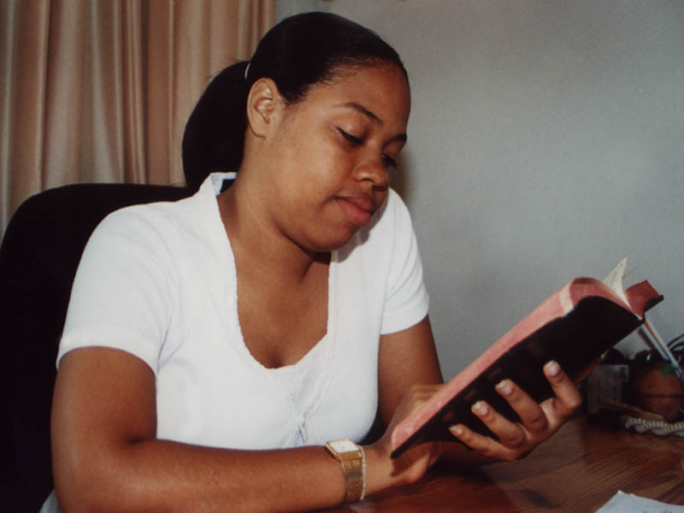
IN SEARCH FOR THE TRUTH-GOD

Slide 20

WAR CONDITIONS-GOD

Slide 21
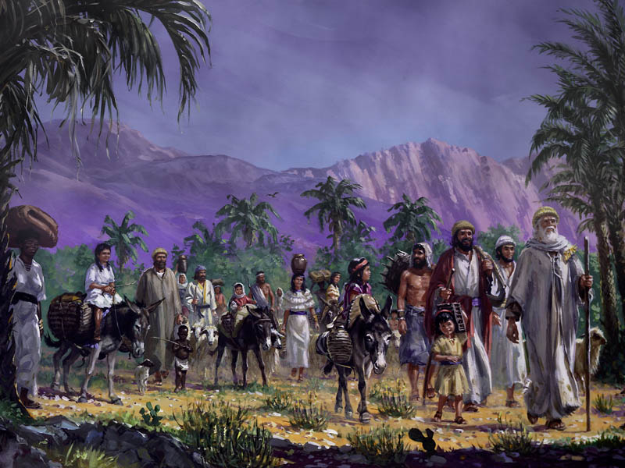
RUNING FROM WAR ZONE-GOD

Slide 22
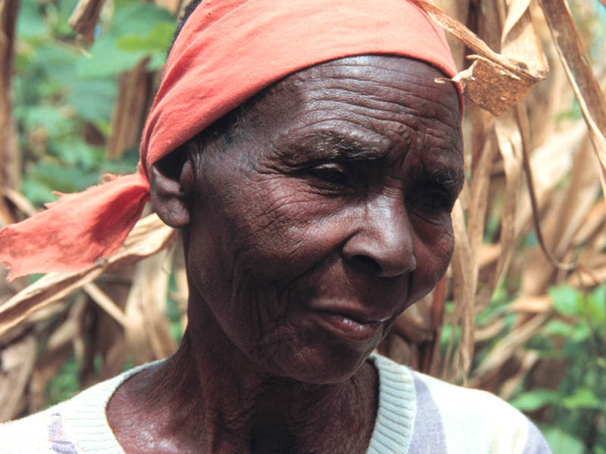
OLD AGE-GOD

Slide 23

THE PHYSICALLY CHALLENGED-GOD

Slide 24
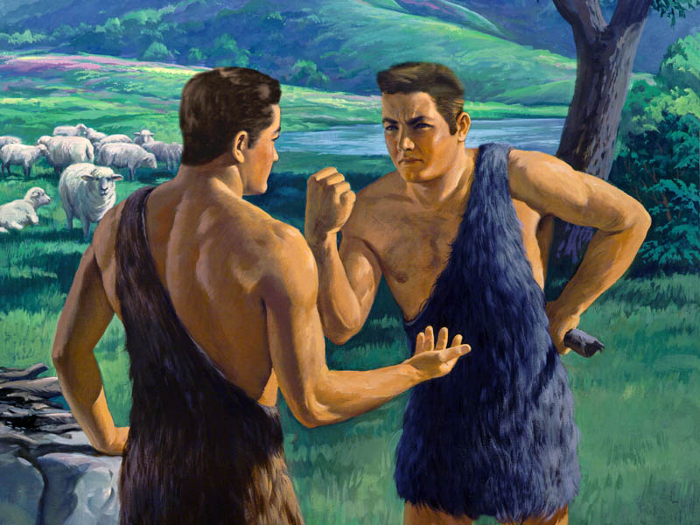
FAMILY STRIFE-GOD

Slide 25
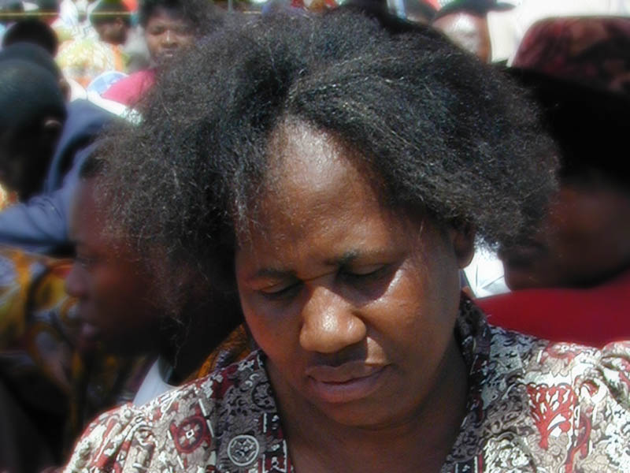
THE STRESSED & AFRAID-GOD

Slide 26
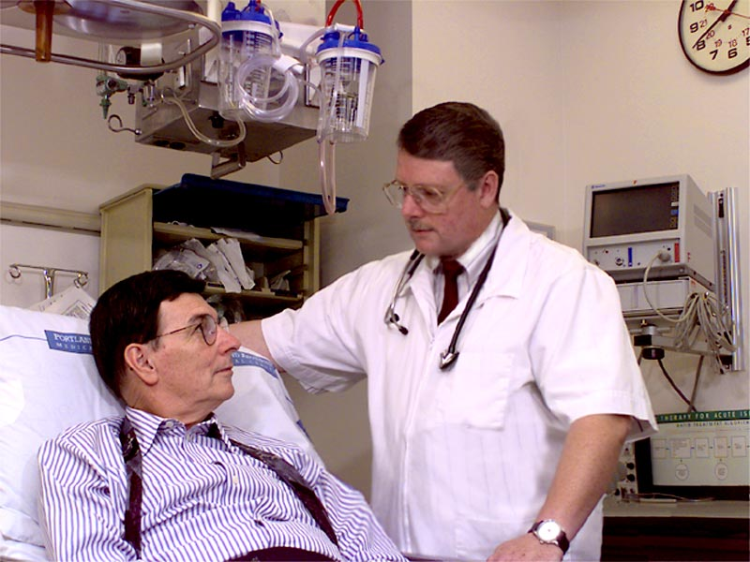
SICKNESS-GOD

Slide 27
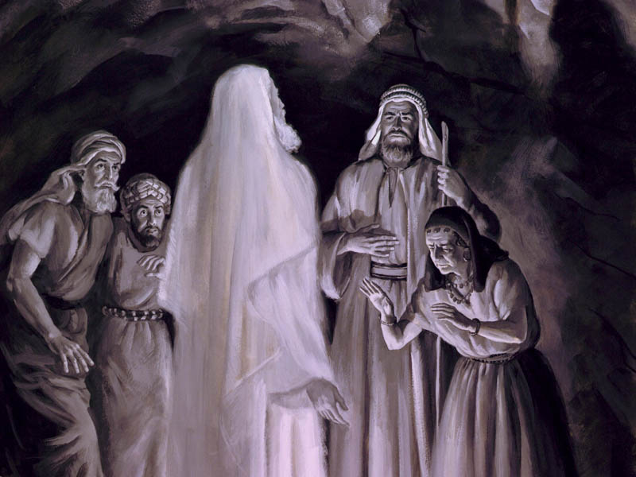
EVIL SPPRITS TORMENT-GOD

Slide 28
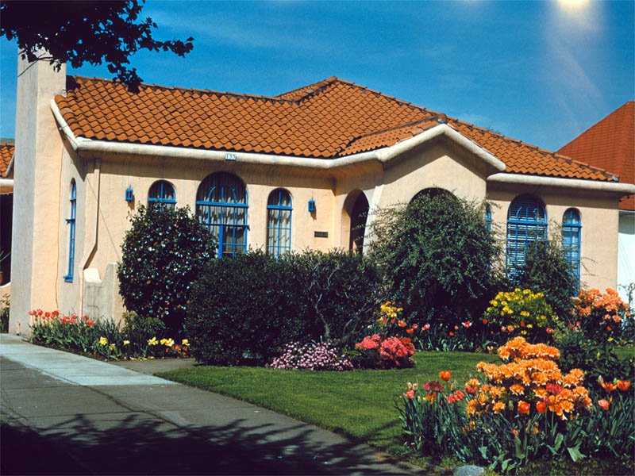
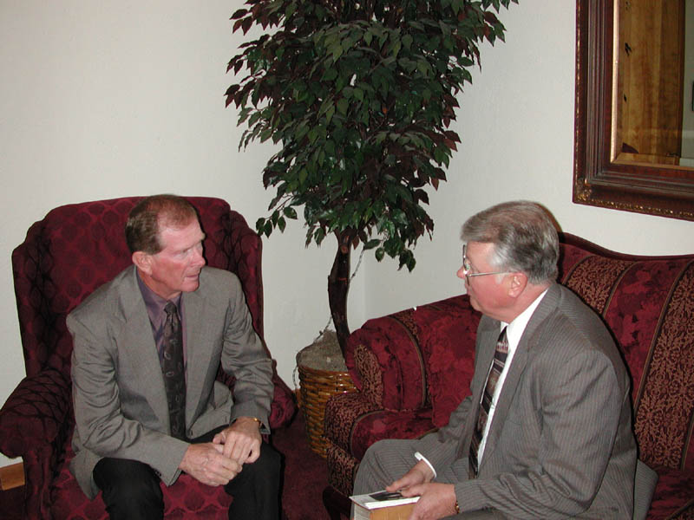
PEOPLE RELOCATING-GOD

Slide 29
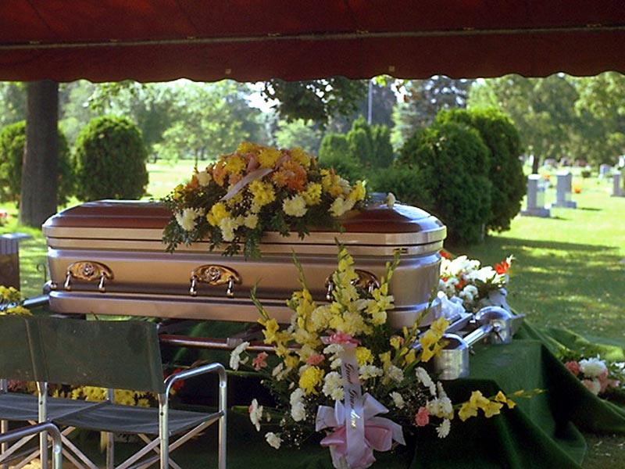
DEATH OF A LOVED ONE-GOD

Slide 30
Methods of personal evangelism
FRIENDSHIP EVANGELISM,ie
JESUS WITH LAZARUS-JOHN11:1,35,36
JESUS WITH A WOMAN AT THE WELL-JOHN4:4-6- WATER USED AS ENTERING WAGE.
THE OIKOS PRINCIPLE;
OIKOS MEANS A HOUSE HOLD
THE FAMILY MEMBERS,AND FRIENDS IS YOUR JERUSALEM,
THE NEIGBORS- IS YOUR JUDEA
THE WORK MATES, AND FRIENDS, IS YOUR SAMARIA

Slide 31
THE SMALL GROUPS MINISTRY
WHY EVERY CHURCH NEEDS SMALL GROUPS
DEFINATION-A SMALL GROUP IS A SMALL NUMBER OF INDIVIDUALS, MEETING TOGETHER ON A REGULAR BASIS,STUDYING THE SCRIPTURES FOR THEMSELVES, CONSTANLY UP LIFTING JESUS, STRENGTHENING, AND ENCOURAGING, ONE ANOTHR, AND ASKING NEGHBORS TO JOIN THEM.

Slide 32
THE BIG DEAL ABOUT SMALL GROUPS
SMALL GROUPS MAKES A CLOSE FAMILY
THERE IS GROWTH IN PERSONAL PRAYER LIFE
YOU EXPERIENCE SPIRITUAL GROWTH
THERE IS ENCOURAGEMENT AND EDIFICATION
THERE IS ONE ON ONE PASTORAL CARE
THERE IS UNLIMITED MINISTRY OPPORTUNITIES
DISCIPLING OF NEW CONVERTS IS BEST ARCHIEVED IN SMALL GROUPS
IT HELPS IN SHAPING OF STRONG LEADERSHIP

Slide 33
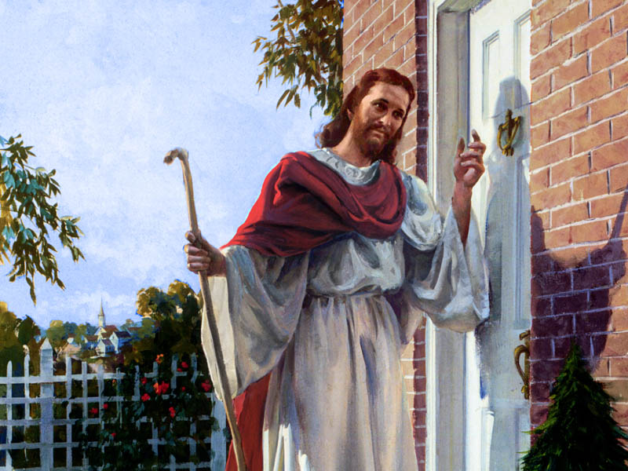
THE F-O-R-T PRINCIPLE

Slide 34
THE FORT PRINCIPLE
WHEN YOU ARE EVANGELISING TO A NEW FAMILY, THOSE YOU HAVE NEVER HAD CONTACT WITH BEFORE, USE THE F-O-R-T PRINCIPLE;
F------- FAMILY
O-------OCUPATION
R--------RELIGION
T--------TESTIMONY

Slide 35
COMMUNITY SERVICES
WHAT METHOD DID JESUS USE IN EVANGELISM, AND HOW DID THIS IMPACT HIS MINISTRY ON EARTH?
THE GOSPEL COMES ALIVE WITH PRACTICAL MINISTRY.
JESUS,S MINISTRY WAS POWERFUL BECAUSE HE ACTED WHAT HE PREACHED, IT WAS A BALANCED MINISTRY.

Slide 36
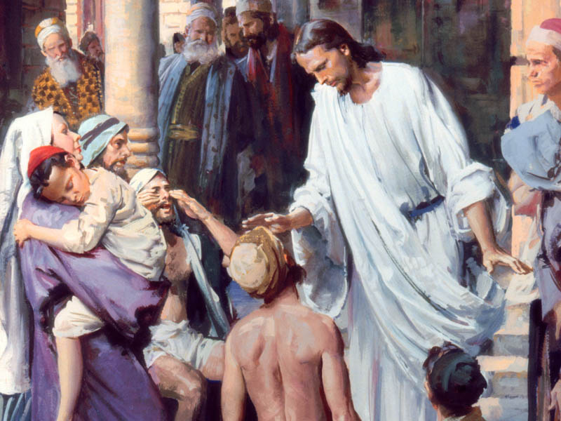
THE SICK/BLIND/CRIPLE/DEAD

Slide 37
DORCAS/AMO
THE ADVENTIST MEN, AND DORCAS ARE A SUBSIDIARY OF THE PERSONAL MINISTRIES DEPARTMENT, IT INCLUDES THE FOLLOWING;
LAY PREACHING
PRISON MINISTRIES
ORGANISING AND PREPARING CLOTHING
FOOD
HOME NURSING
CONSELLING
CARING FOR THE AGED
WIDOWS/OPHANS
HOSPITAL VISITATIONS etc

Slide 38
Mathew 25:35
I WAS HUNGRY- YOU GAVE ME FOOD
I WAS THIRSTY- YOU GAVE ME WATER
I WAS A STRANGER- YOU WELCOMED ME
I WAS NAKED – YOU CLOTHED ME
I WAS SICK- YOU TOOK CARE OF ME
I WAS IN PRISON- YOU VISITED ME
WEST ZIMBABWE CONFERENCE

Slide 39
MATHEW 28:18
ALL POWER IS GIVEN TO ME GO YE THEREFORE

Slide 40
WHAT LAY PREACHERS OUGHT TO DO
STUDY TO SHOW YOUR SELVES APPROVED WORK MEN/WOMEN
BE A TRAINED LAY PREACHER
BE A LICENCED LAY PREACHER
ALWAYS CONSULT WITH YOUR LOCAL LEADERSHIP,AND THE PASTOR,AND LOCAL CONFERENCE
BE ORGANIZED-PUNCTUAL AND NEAT
HAVE ADEQUATE PREPARATIONS FOR YOUR CRUSADES
PREACH IN SEASON AND OUT OF SEASON

Slide 41
THEME
THE POWER OF ONE !
ONE MEMBER ONE SOUL

