Slide 1
Impact South Africa
Promotional Presentation
Presented by Highten Hamweene
Youth Director, Lusaka Conference

Slide 3
What?
Impact South Africa
World Conference on Youth and Community Services

Slide 4
When?
July 1 to 13, 2013

Slide 5
Community Service Projects (CSP) - July 1 to 5, 2013
Youth and their leaders are encouraged to participate in the complete experience, beginning with community service projects, before converging on Pretoria for the congress.
All projects will have some cost attached to them. Contact your youth department for project proposals and budgets.

Slide 6
Youth Congress - July 8 to 13, 2013
Youth and their leaders will share in the unique experience of being part of the global youth community, learning about discipleship, training and becoming equipped for mission, and being inspired by Spirit-filled worship and messages from anointed speakers.

Slide 7
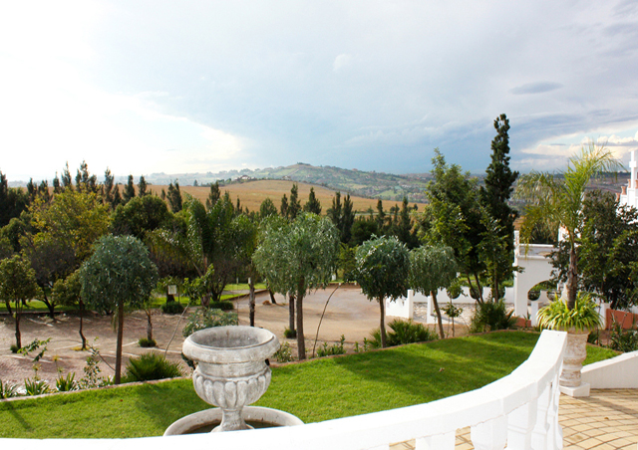
Where?
Pretoria, South Africa at Saint George Hotel

Slide 8
Saint George Hotel
The Congress will be held in the Saint George Hotel. It has 30 multi-functional conference venues and has a true Mediterranean style. It is situated 20 minutes from O.R Tambo International Airport, and is secluded with its lush green gardens and classical Greek influenced buildings.

Slide 9
The overall objectives of the WCYCS are:
Celebrate God’s grace as a global family of Adventist youth.
Foster and develop friendship, community, and global unity among the diversity of nations and cultures that our world church represents.
To experience revival and reformation through a fresh outpouring of the Holy Spirit.
To mobilize a global Discipleship movement to extend God’s Kingdom worldwide.
To re-establish Mission as a priority for global youth.
To provide firsthand experience in frontline Mission and Service.

Slide 10
Detail
The World Conference on Youth and Community Services will convene in Pretoria, South Africa from July 1 to 13, 2013. Youth from around the world will participate in this noble cause. The project will bring senior youth and young adults, ages 18 to 30+, from every world division of the church. One week will be set aside for the youth and their leaders to be involved in youth-oriented service projects.

Slide 11
Pretoria and the surrounding areas will be impacted by the love of God through the lives of the Seventh-day Adventist youth. Community leaders will be approached and will propose ways in which we can bring a contribution to their communities. Our own young people will maximize their skills as they work together in the development and improvement of the communities they will serve. A door to mutual understanding and cooperative spirit will be opened through exchanges between culturally diverse young people serving in multi-cultural communities.

Slide 12
Registration
$ 200 – Up to December 31, 2012
$ 250 – After December 31, 2012
All Registration Payments to be made by 31st March 2013

Slide 13
Accommodation

Slide 14
Featured Speakers

Slide 15
David Asscherick

Slide 16
David Asscherick is co-director of Light Bearers and co-founder of ARISE. He has spent the last 15 years traveling the globe preaching and teaching the gospel of Jesus Christ. He is the author of God in Pain: Another Look at Evil, Suffering, and the Cross, his first book. He and Violeta, his wife of 13 years, are the happy parents of two boys, Landon and Jabel. They enjoy backpacking, climbing, running, fly fishing, and reading.

Slide 17
Ted N. C. Wilson

Slide 18
Ted N. C. Wilson was elected as president of the Seventh-day Adventist world church in July 2010 during the General Conference Session in Atlanta. Born in Takoma Park, Maryland on May 10, 1950, the son of former General Conference President Neal C. Wilson and Elinor E. Wilson spent part of his childhood in Egypt.

Slide 19
Dr. Benjamin S. Carson, Sr.,

Slide 20
Dr. Carson is a full professor of neurosurgery, oncology, plastic surgery, and pediatrics at the Johns Hopkins School of Medicine. In 1984, he was named director of pediatric neurosurgery at Johns Hopkins Children's Center, a position he still holds today.

Slide 21
Devotional Speakers

Slide 22
James Black, Sr

Slide 23
Pastor James (JB) Black, Sr. is the Director of Youth Minsitries for the North American Division. He oversees Teens, Pathfinders, Adventurers, Master Guides, Young Adults, Adventist Christian Fellowship, and Camp Ministries. Large networks of empowered leaders have been mobilized for each of these ministry disciplines.

Slide 24
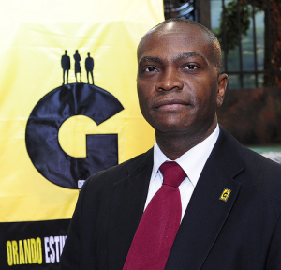
Anthony Hall

Slide 25
Anthony S. Hall was installed as the Youth Ministries Director of the Caribbean Union Conference on July 17, 2011. A native of Barbados, Anthony grew up in the village of Cave Hill. By age seventeen Anthony had assumed the following roles: Pathfinder Director, AY Leader, and Elder of the Ebenezer Seventh-day Adventist Church, Barbados. He was ordained and set aside to the gospel ministry in 1997 and has served with distinction in Barbados, St. Lucia and Trinidad over the past 20 years.

Slide 26
Plenary Session Speakers

Slide 27
Gilbert Cangy

Slide 28
Gilbert was born of missionary parents in the Seychelles Islands. He grew up in Mauritius with his six brothers and sisters and joined the Merchant Navy as a cadet officer after his high school years. Gilbert graduated from Avondale College in 1987 and pastored in the state of Victoria for six years before being called to be Youth Director in Sydney in 1993. In 1999, he was appointed as the Director for Youth Ministries for the South Pacific Division. In 2009, he asked for a change to pastor a local church in Sydney, from where he was called to be the General Conference Youth Director in 2010. Gilbert obtained a Masters in Youth Ministry from La Sierra University in 1997 and is currently working on a Doctoral program. His dream is to see youth take hold of the mission for the church and stand up as a global movement for Jesus to bring hope and meaning to our hopeless world.

Slide 29
Dr. Benjamin S. Carson, Sr. , M.D

Slide 30
Dr. Carson is a full professor of neurosurgery, oncology, plastic surgery, and pediatrics at the Johns Hopkins School of Medicine. In 1984, he was named director of pediatric neurosurgery at Johns Hopkins Children's Center, a position he still holds today. In 2008, he was named the inaugural recipient of a professorship in his name, the Benjamin S. Carson, Sr., M.D. and Dr. Everlyn Spiro, R. N. Professor of Pediatric Neurosurgery.

Slide 31
Dr. Ganoune Diop

Slide 32
Dr. Ganoune Diop is Director of United Nations Relations and Associate Director of Public Affairs & Religious Liberty. For the past four years he served as Director of Global Mission Sutdy Centers of Adventist Mission.
Dr. Diop has a Masters in Exégèses and Theology from Collonges, France, a Masters degree in Philiology from the University of Paris, and a Ph. D. in Old Testament Studies from Andrews University. He is a Ph. D. candidate in New Testament Studies. He is also an ordained Seventh-day Adventist minister.

Slide 33
Andrew Daryl Gungadoo

Slide 34
Ted N. C. Wilson

