Slide 1
2013 WORKERS MEETING

Slide 2
THE WORK & MINISTRY OF THE COMMUNICATION DEPT
Impact & Relevance through the Powerful Influence
By Highten Hamweene

Slide 3
4-Focus Areas, Dr. E. Shimunzhila
Human Resource
In-reach
Outreach
Infrastructure

Slide 5
What is Communication?
Communication is simply the activity of conveying information

Slide 6
It is also a connection allowing access between persons or places

Slide 7
VISION
To create a favorable image of the church, its mission, life, witness and related activities by using the most effective means of communication.

Slide 8
VALUES
Our commitment to communicate hope by focusing on the quality of life that is complete in Jesus Christ.
Our commitment to creative relevance (1 Cor 9:19)

Slide 9
Our commitment to standards of excellence (1 Cor 3:13)
Our commitment to express all communication in the context of the church’s strategic values of unity, growth and quality of life.

Slide 10
What Comes to mind when you hear the word “Communication”?
Camera
TV
Newsletter
Telephone
Cell phone
Fax
Sender
Receiver

Slide 11
The Need for a New Understanding
“We must take every justifiable means of bringing the light before the people. Let the press be utilized, and let every advertising agency be employed that will call attention to the work.”—Testimonies, vol. 6, p. 36.

Slide 12
Admonition from SOP
“Means will be devised to reach hearts. Some of the methods used in this work will be different from the methods used in the work in the past. . . .”—Evangelism, p. 105.

Slide 13
GOALS
Develop local church communication secretaries to the level of relevance through training
Maintain an open door for consultation in communication at the Lusaka Conference
Continue to implement world church corporate identity (logo) Conference wide

Slide 14
Colors: Gold, Green & Grey

Slide 16
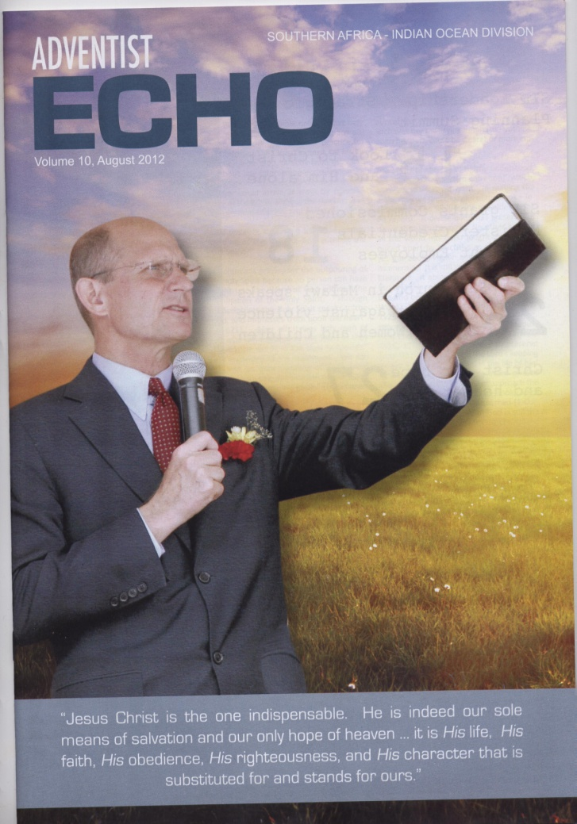
Develop a Conference Magazine

Slide 17
Goals Cont.
Develop a Conference Website - http://lusakaconference.adventisthost.org
Deliver current news and information through our LC Magazine and Website
Foster implementation of internet based ministry
Provide communication assistance to church administration, ministers, and churches

Slide 18
PR & Communication
“The Communication Department promotes the use of a sound program of public relations and all contemporary communication techniques, sustainable technologies, and media in the promulgation of the everlasting gospel. It calls for the election of a Communication secretary in every local church and, where needed, a Communication Committee.” p 122 CM 17th Ed

Slide 19
The core of public relations work is relationship management.

Slide 20
The Communications Secretary
Should be promoted as an important leader of the church

Slide 21
Qualifications
—The Communication secretary should be carefully chosen for (1) the ability rightly to represent the church, (2) sound judgment, (3) organizational ability, (4) ability to put facts down on paper in attractive and persuasive grammatical form, (5) willingness to carry out an assignment, (6) ability to meet people.

Slide 22
Communication Secretary’s Work
“The church Communication secretary is responsible for the gathering and dissemination of news. As opportunity presents, the secretary will place on the air persons of interest in interview-type programs, and arrange for news features on such persons. Every effort will be made to maintain a friendly, cooperative relationship with editors and other communications/media personnel.” Ibid p 122

Slide 23
Communication Committee
—In a large church a Communication Committee may more adequately handle the many facets of the public relations and communication program of the church than can a secretary working alone. This committee, with the Communication secretary as chairperson, will be elected at the time of the general election of church officers.

Slide 24
Individual members of the committee may be assigned specific communication responsibilities, such as working with the press, with media producers and online personnel, and with the internal media of the church. Where there is a church institution in the area, a member of its public relations staff should be invited to sit with the committee.

Slide 25
The Pastor: A Key Player
The pastor, who is primarily responsible for the communication program of his church, will work closely in an advisory capacity with the Communication secretary and/or the Communication Committee.

Slide 26
The Highest Communication Leader
In a District, the pastor is the highest ranking officer in as far as communication is concerned.

Slide 27
Vital Functions/Tasks
Ensuring the presence of sign posts with current church logo at our churches
Ensure that such sign posts are clear and legible

Slide 31
Solicit articles from local members & send news articles to the Conference Communication Department (Articles must answer - What, When, Where, Who, Which, How)

Slide 32
Ensure the presence of a fine quality church owned camera (for still or moving picture production)

Slide 33
Coordinate the featuring of church activities on radio or television (e.g. CV, ZNBC, MOBI, MUVI...)
Organize communication workshops

Slide 34
Note interests generated due to communication department efforts
Organize for the development and production of church papers such as a Newsletter, magazine, or brochure

Slide 35
Work toward the production of a church bulletin
Note the presence of journalists who can be helpful in providing professional insights in your work
Work towards the opening of a church website: www.johnhowardsda.org

Slide 36
Vital Reminder
Remember that if a program is to be aired on TV/Radio for purposes of giving the public an official position of the Seventh-day Adventist Church, consent must be obtained from the office. Such protocol protects the organization and ensures release of information in a calculated manner.
By policy, only designated officers should express denominational position to the public.

Slide 37
Free hosting Websites for Church Intuitions
The website proposal presents an opportunity to harness technology in the gospel commission. This presents untold opportunities for both in reach and outreach. Thus far, the world has used this tool to present its mission, at the expense of the church’s mission. This proposal strives to size up, and perhaps bypass, this challenge.

Slide 38
Free hosting Websites for Church Intuitions - What are the benefits and features?
For church/district/conference - create an avenue where church members and workers can:
View church/district/conference information
View church/district/conference events calendars, such as preaching rosters, church meetings, announcements, events, success stories, products etc.
Automate meeting calendars and automatically send via email, meeting reminders
View departmental reports
View contact information for relevant departmental leaders/directors

Slide 39
Free hosting Websites for Church Intuitions - What are the benefits and features?
Create a plat form for the outside world to look into the ministry of the church. This would also include creating an avenue for prospective members to request for visitation, baptism, prayers etc.

Slide 40
Free hosting Websites for Church Intuitions - What are the benefits and features?
Create an avenue where church members can download materials, such as church manuals, week of prayers materials, other departmental manuals etc.

Slide 41
Free hosting Websites for Churches - What are the benefits and features?
Church web presence at low cost (and zero cost in some cases)
Improved communication
Improved coordination
Improved transparency
Improved long term storage
Improved order and organization
Improved standards etc

Slide 42
Free hosting Websites for Church Intuitions- How to Implement the Project?
Development : FREE
Training Through Wilberforce Academy
Introduction to Computers [K50,000]
Word Processing [K50,000]
Internet and eMail [K80,000]
Using the Website [K80,000]
Website Maintenance and Updates: FREE

Slide 43
Thought of the Day
“... knowledge shall be increased.” (Dan 12:4).

Slide 44
“80% of all the scientists who have ever lived are alive today. Every minute they add 2000 pages to man's scientific knowledge, and the scientific material they produce every 24 hours would take one person 5 years to read. About a half-million new books are published every year.”
http://www.countdown.org/armageddon/knowledge.htm

Slide 45
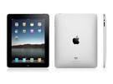
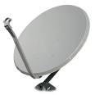

Slide 46
Contact Details
Lusaka Conference
Cnr. Independence Avenue/Burma Rd
Plot No. 9221
P.O. Box 37155, Lusaka, Zambia
Mobile: +211 258930/ +211 258931
Website: http://lusakaconference.adventisthost.org
Communications Director: 0977530101

