Slide 1
CHURCH GROWTH
GROWING LUSAKA CONFERENCE

Slide 2
Presented By Dr. Shimunzhila

Slide 3
LUSAKA CONFERENCE 2013-2015
HUMAN RESOURCES INFRASTRUCTURE
IN REACH OUTREACH
CHURCH GROWTH

Slide 4
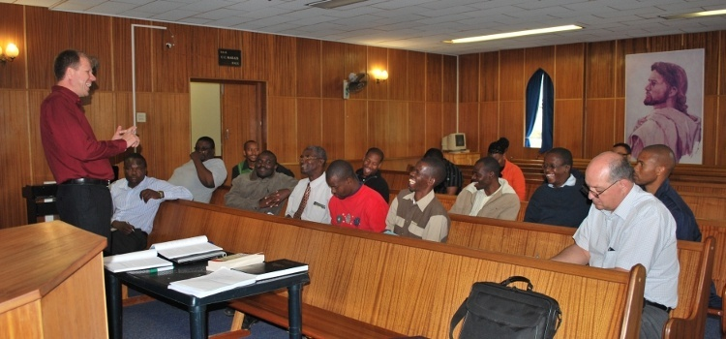
HUMAN RESOURCES
Training Pastor’s and Elders
Leadership Skills
Conflict Management
Definition of Leadership

Slide 5
INREACH
Bible Studies in Churches
Instructing Bible Class members
Church Members learning 28 Fundamental Beliefs and 10 Commandments
Every Member a bible, Hymn book and Study Guide

Slide 6
OUTREACH
Person to Person Evangelism

Slide 7
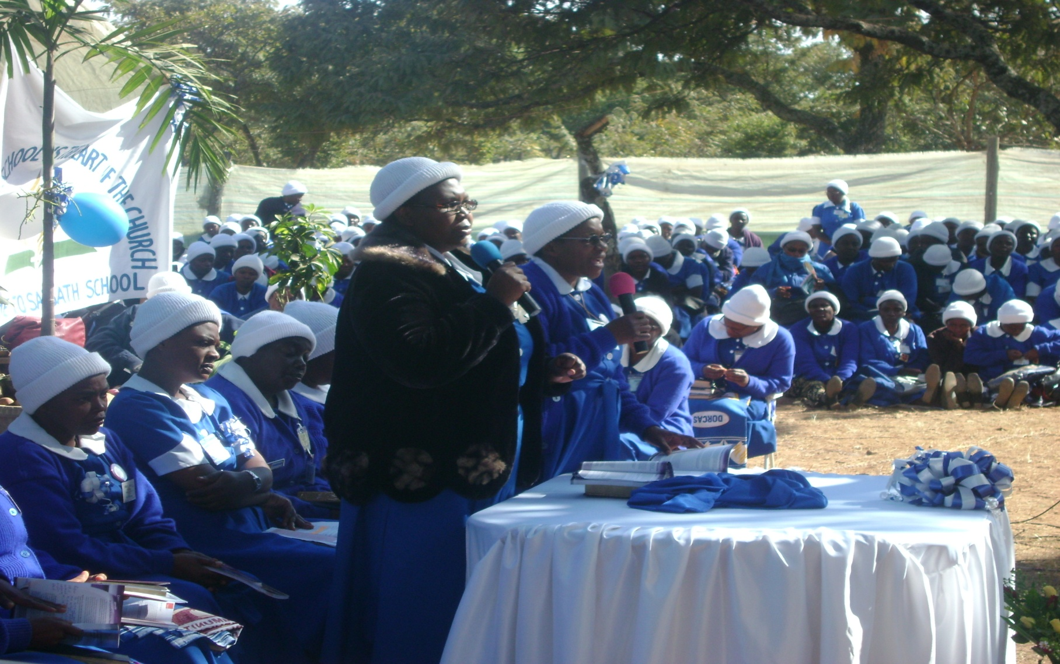
Out Reach
Public Evangelism

Slide 8
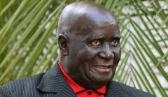
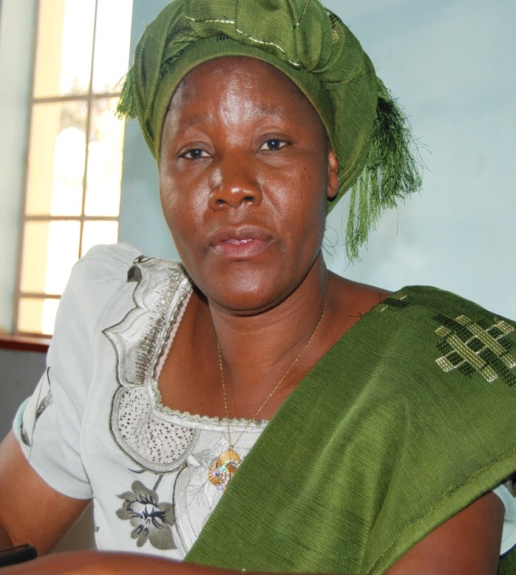
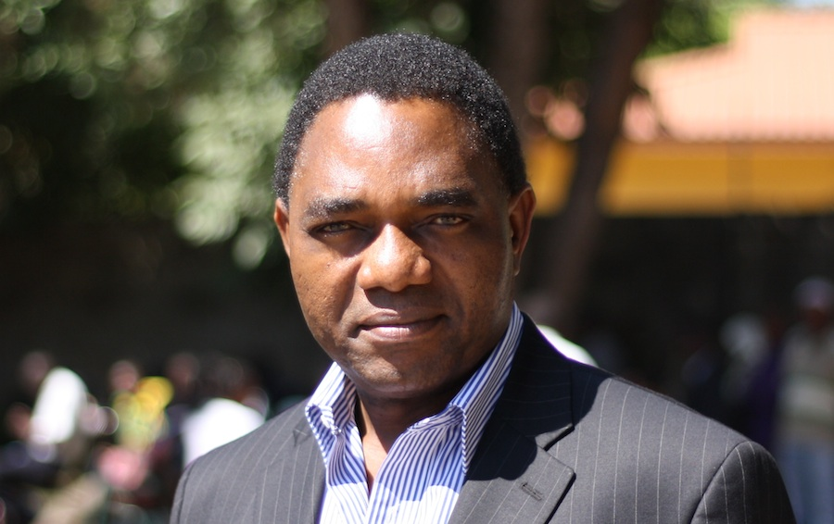
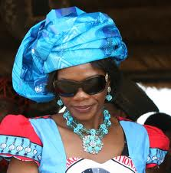
Visiting the Government Officials & Opposition Leaders

Slide 9
Better Church Buildings

Slide 10
Better Accommodation for Workers

Slide 11
AMO Involvement

Slide 12
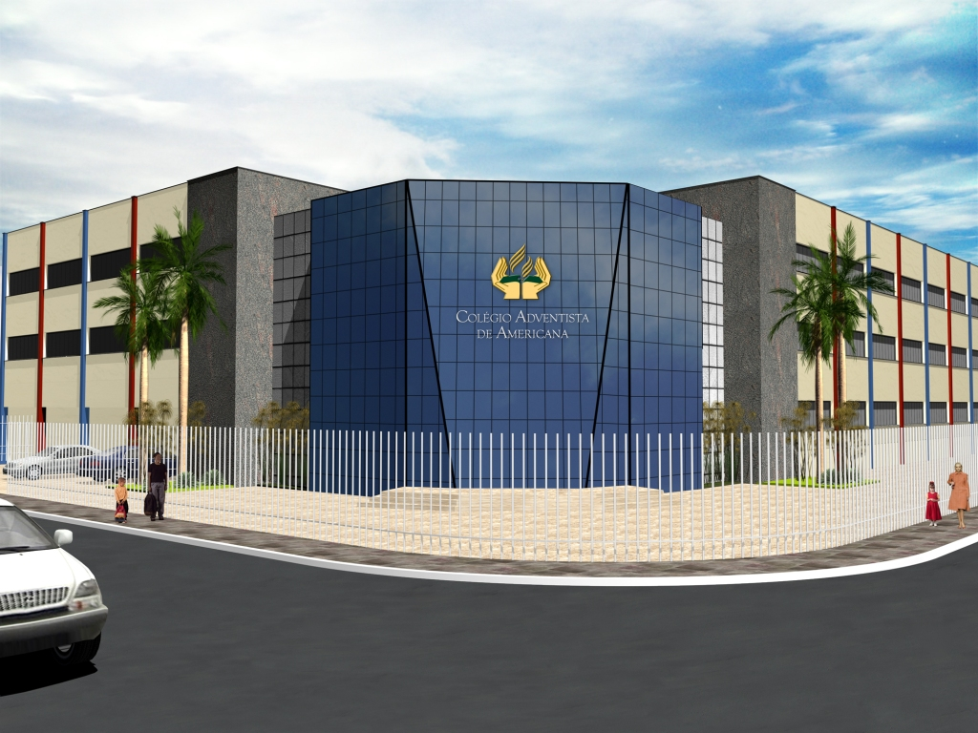
Infrastructure

Slide 13
Organizing Companies to Churches

